Slide 1
Other Advanced AWS Services

Slide 2
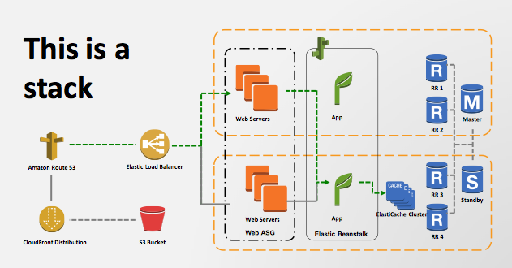
Cloud Formation
The entire system is considered a stack
Template file describing a stack
Makes it easy to launch the entire stack in different environments
E.g. Development, Test and Production
E.g. Copy entire stack from for one region into another region

Slide 3
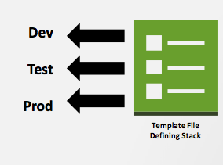
AWS CloudFormation
You can use the template to quickly build out multiple environments, such as for Development, Test, and Production.
Below is an example application stack

Slide 4
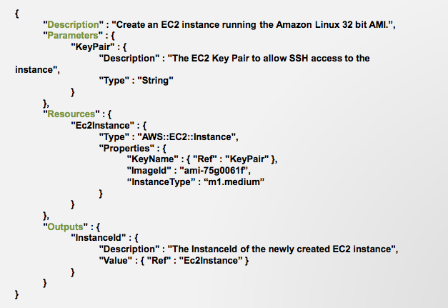
Example Cloud Formation Template

Slide 5
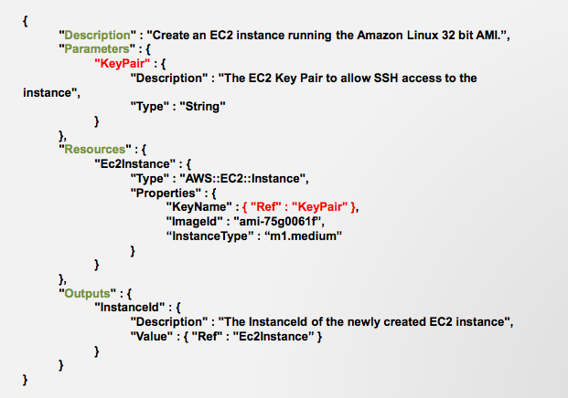
Need EC2 key pair

Slide 6
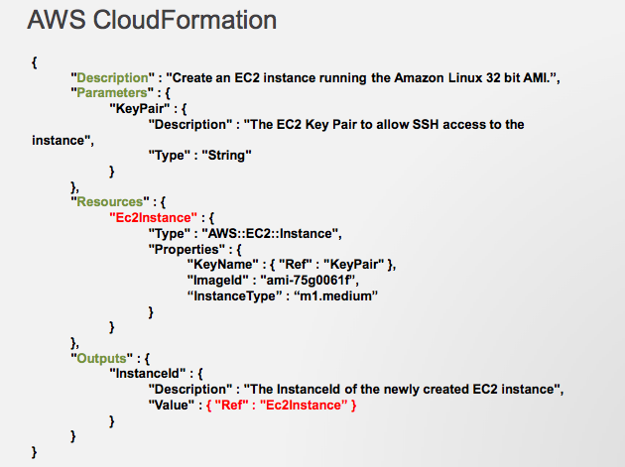
Specify the type of EC2 Instances

Slide 7

Amazon Route 53
Global network of DNS servers that answer DNS queries with low lantency

Slide 8
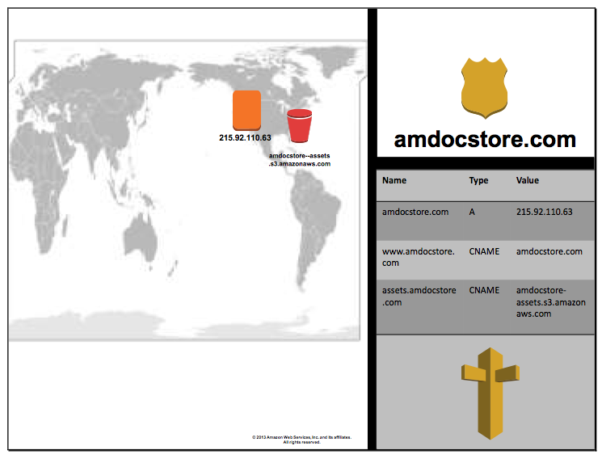

Slide 9
Route 53
Can be used for load balancing across regions
In contrast, the elastic load balancer can only be used to balance load across availability zones of a single region.
Round robin load balancing

Slide 10
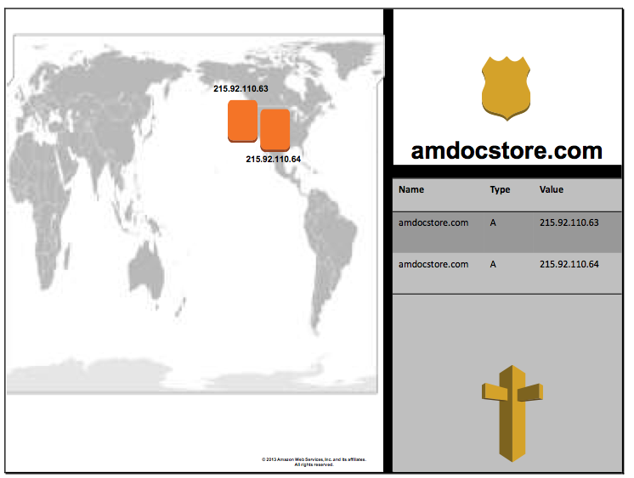
Requests for a web application split evenly

Slide 11
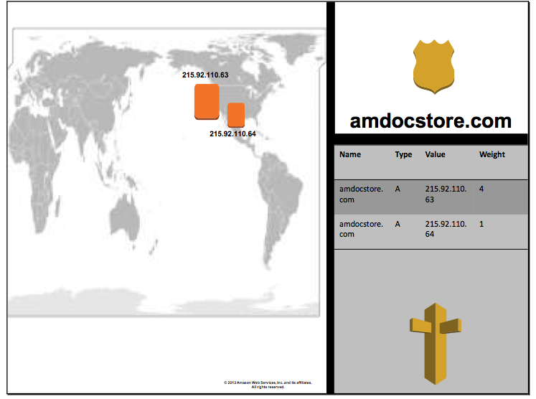
Weighted Round Robin
Configured to send 4 times more traffic to one server than the other

Slide 12
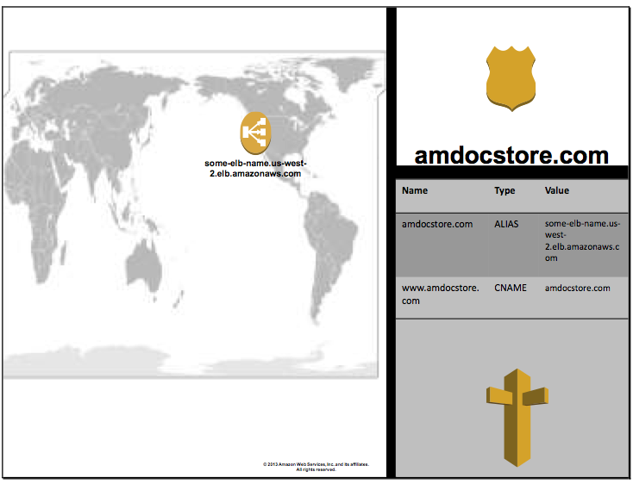
Configured to send traffic to elastic load balancer

Slide 13
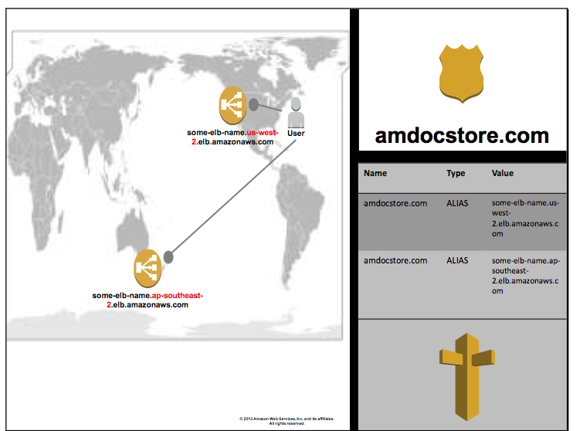
Latency Based Routing

Slide 14
Amazon CloudFront
A content delivery service
Basically caches data on servers closer to the user
Web service for content delivery
Distribute contents to end users with low latency, high data transfer speeds.
Delivers your content using a global network of edge locations
Supports downloads, dynamic, streaming and live streaming

Slide 15
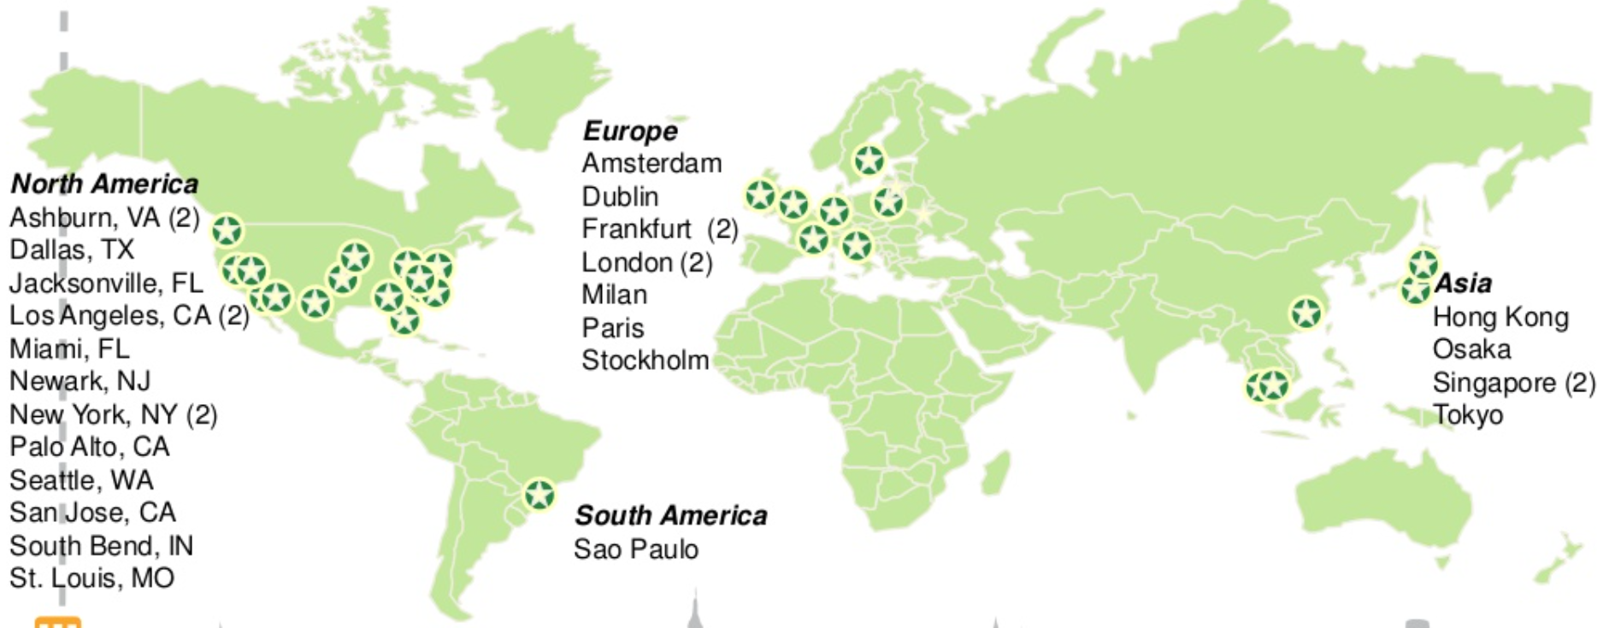
Cloud Front’s Global Presence

Slide 16
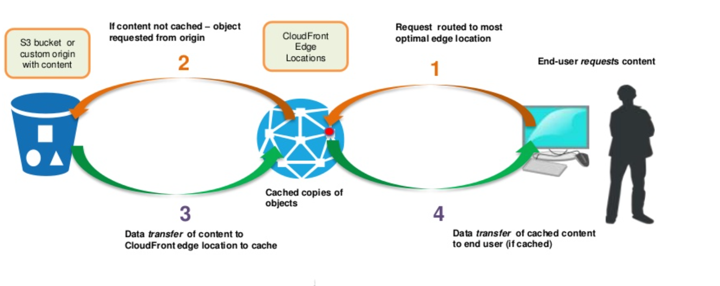
How Cloud Front Works (non-cached Object)

Slide 17
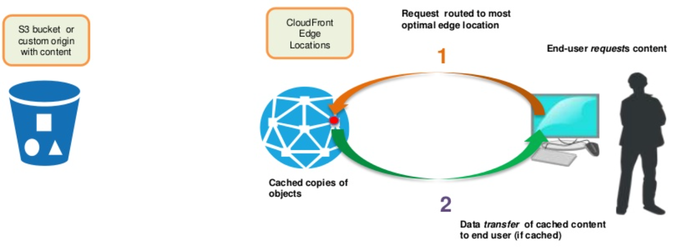
How Cloud Front Works (cached Object)

Slide 18
Amazon Relational Database Service (RDS)

Slide 19
Solution for Database
One choice: Build your own
Acquire virtual machine instances
Install the database yourself
Self manage your database
Pay a lot of money to hire a database administrator
Another choice: Database-as-a-service
Amazon relational database service (RDS)
A service make it easy to
Setup
Operate
Scale

Slide 20
RDS Features, Functionalities
Pre-configured Parameters
Monitoring and Metrics
Automatic Software Patching
Automated Backups
DB Snapshots
Push-Button Scaling
Replication: two features
Read replicas
Multi-AZ deployment

Slide 21
RDS Supported Databases
MySQL
Microsoft SQL
PostgresSQL
Oracle
Amazon Aurora

Slide 22
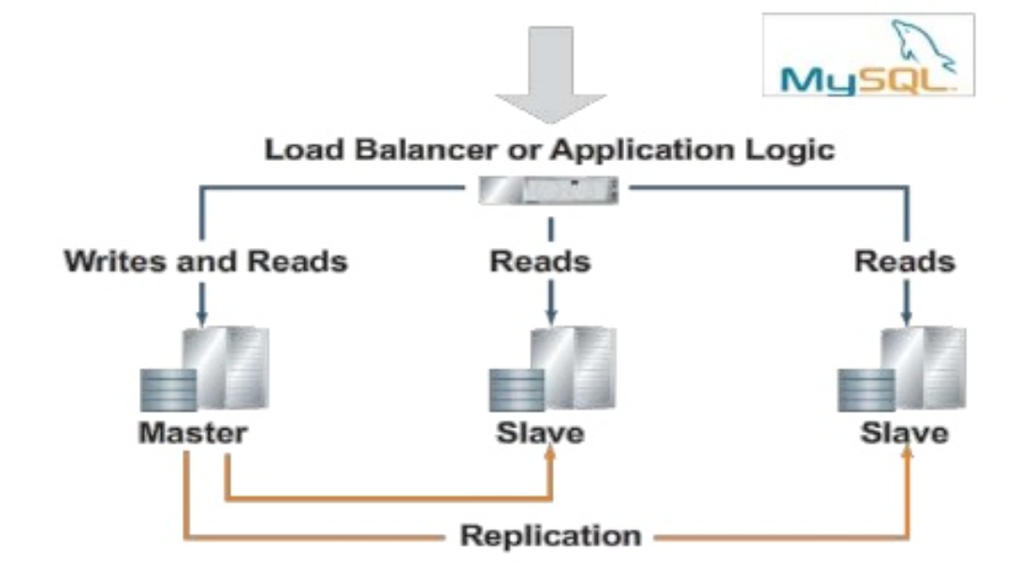
Read Replicas
Master-slave architecture
Master responsible for all writes
Writes are replicated to slaves
Reads can be done by master or any slave
Good option to take when there is a high read to write ratio

Slide 23
Multi-AZ Deployment
Entire database is replicated across availability zones
RDS makes replica up-to-date behind the scenes
The standby DB takes over in failover scenarios
Double the price

